Slide 1

New YORK Airbnb DATASET Presentation 1
Presented By- Pratibha Chougule

Slide 2
AGENDA
Objective
Background
Key Findings
Recommendations
Appendix:
Data sources
Data methodology
Data model assumptions

Slide 3
Objective
Airbnb needs to take as a business, to analyze a dataset consisting of various Airbnb listings in New York.
Improve our strategies to revive the business in the post-COVID period.
Understand key insights from Airbnb NYC business in pre-COVID period.
Estimate customer preferences for the post-COVID period travel.

Slide 4
Background
The COVID-19 pandemic affected Airbnb business due to travel restrictions.
The revenue took the largest hit in NYC in the Q2 of 2020.
Now that the travel restrictions are lifted, the business should be operated to recover the loss.

Slide 5
Key Findings
Customer preferences and ratings of different hosts of Airbnb in were analyzed.
The data was analyzed to derive key insights from the Pre-COVID period.
The insights will be used to take decisions for the NYC Airbnb business for travel in post-COVID period.

Slide 6
Data Preparation and Cleaning
Data is interpreted as column headers (field names).
Data is interpreted as values in the data source.
Data derived from an Excel merged cell is interpreted as value in data source.
Data is ignored and not included as part of the data source.
The data was analyzed using simple statistical analysis of the data.
The visualizations were derived using the Tableau to understand key inferences from the analysis.

Slide 7
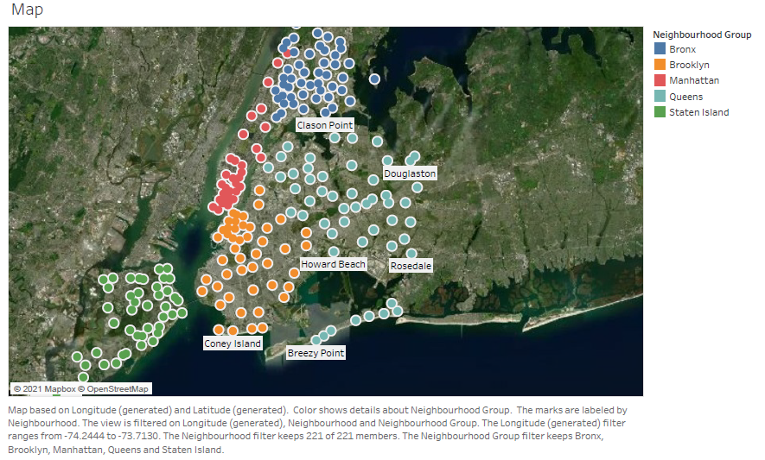
New York Airbnb Neighborhood Group Location

Slide 8
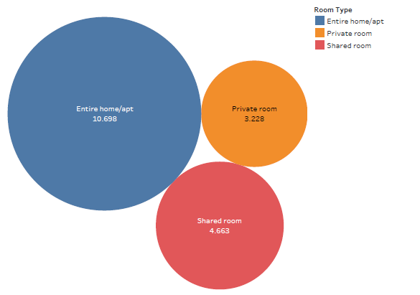
Customer Preferences of the Three Property Types

Slide 9
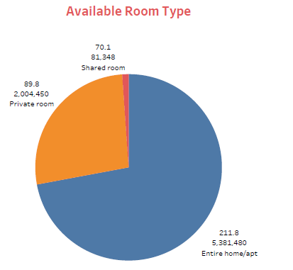
Available Room Type in Airbnb
Distribution of rooms available in comparison with Total Price and Average price.
Entire home/apt is mostly available in New York having max sum of price.

Slide 10
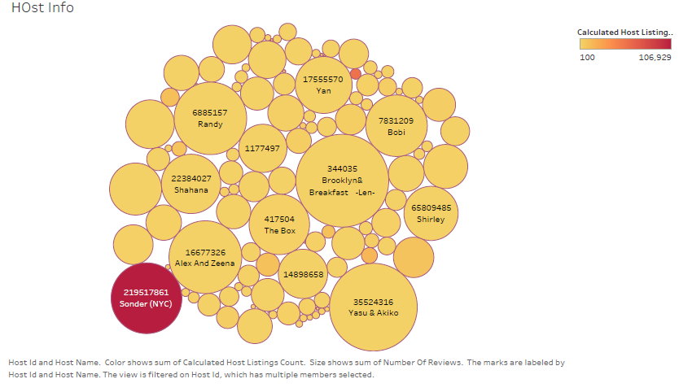
Airbnb Host Information with sum of listing
These are Host Name holding no. of listing properties.
Sonder(NYC) Host Has most no. of listing of properties.

Slide 11
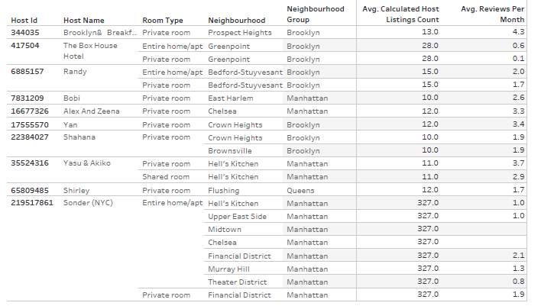
Details of Top 10 New York Airbnb Host

Slide 12
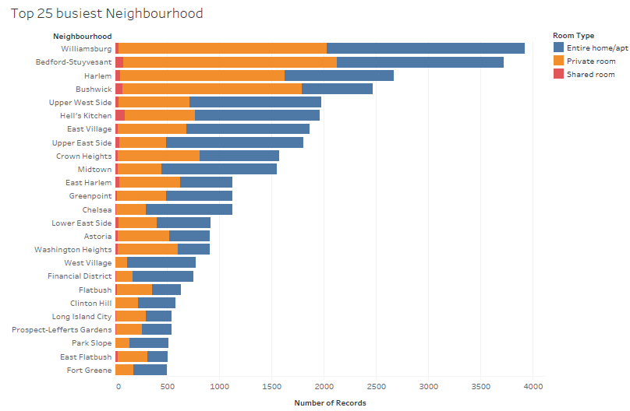
Top 25 Busiest Neighborhood in Airbnb

Slide 13
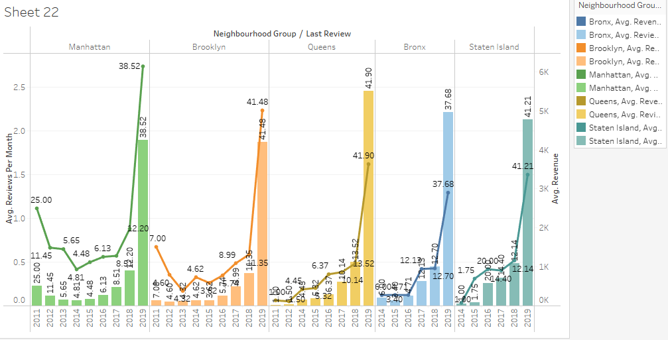
Year wise Preferences by Customers

Slide 14
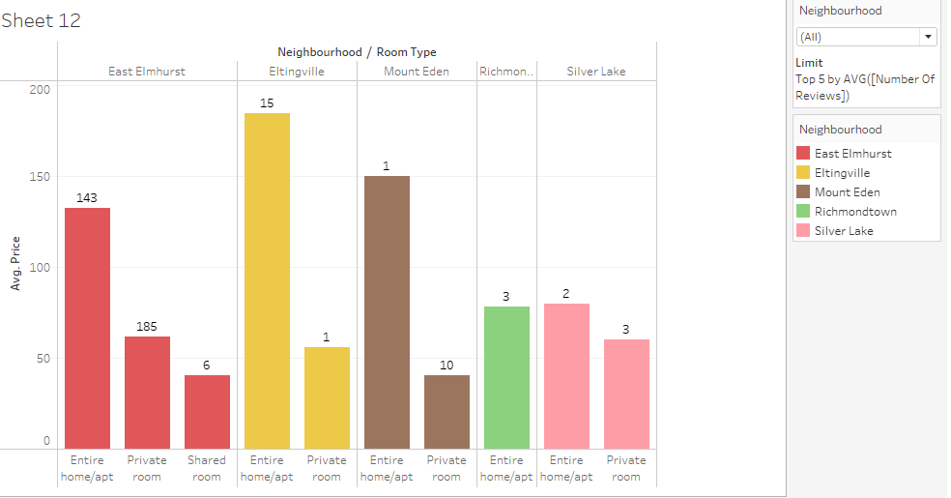
Top 5 Neighborhood Properties Preferred by Customers

Slide 15
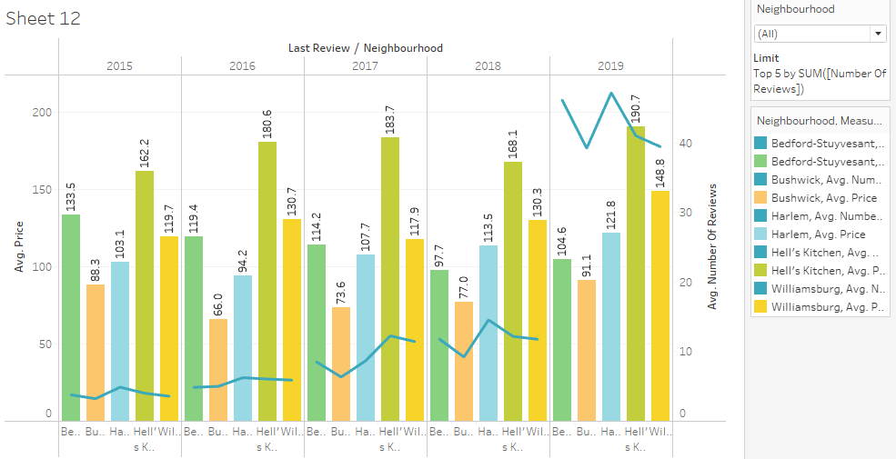
Recent 5 Year Preferences by Customer

Slide 16
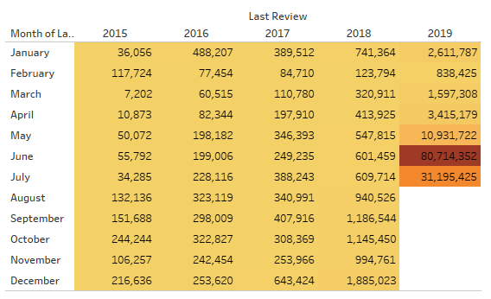
Revenue Generated Till Lockdown

Slide 17
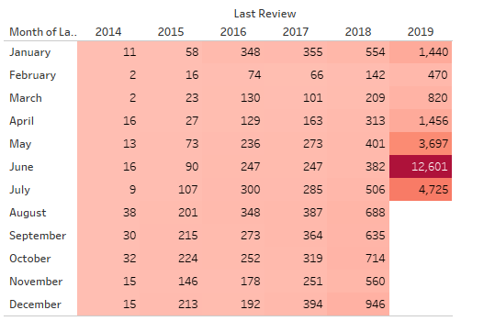
Counts of Minimum Nights Per Month in a Year

Slide 18
APPENDIX - DATA METHODOLOGY
We conducted a thorough analysis of the Airbnb data.
The process included:
Cleaning the data set for missing values and outliers
Using tableau to identify customer preferences based on
Area preferences
Price
Listing Preference

Slide 19
APPENDIX - DATA ASSUMPTIONS
We assumed the data prior to the COVID – 19 period was achieving the desired revenue.
We assumed the company does not want to expand yet to new territories in NYC.
The company’s strategies are decided considering the travel will increased in the post COVID period.

